Slide 1



Coaching Pathways
Template

Slide 2


Please remove available multi-sport modules
When adapting the NCCP Pathway Graphics…
Wherever possible, leave the existing wording as it is to ensure consistency and to make the translation process easier.
When possible and applicable, it is encouraged to provide a link to a website where information can be found. This is preferred over duplicating information, as long as it is ensured that the website link will not change.
Highlight changes to ensure the least amount of revisions required for translation.
Use the Find and Replace function to replace <InsertNSO> with the full name of your NSO. Do this before you start making any changes.
Insert your NSO logo where this placeholder is:
Add any other required licenses relevant to your sport.
If used, images should be replaced.
Please remove section called Available Multi-Sport Modules on each slide before finalizing
When you have finished sportifying the NCCP Pathway Graphics:
Delete this page and all other instructions
Send it to your CAC Coaching Consultant for validation prior to translation
Best to export slides as .jpeg for best resolution
Read me first!

Slide 3
COMMUNITY
(COMMUNITY SPORT – INITIATION)
ATHLETE AGES:
6-12
LTD STAGE(S):
ACTIVE START
FUNdamentals
CONTEXT:
Community Programs
Club
NCCP
Workshop
NCCP Make Ethical Decisions
NCCP example 1
NCCP example 2
IN-TRAINING
TRAINED
NCCP
Coaching
Streams
COMPETITION
(NCCP COMPETITION-INTRODUCTION)
ATHLETE AGES:
8-14
LTD STAGE(S):
Learn to Train
Train to Train
CONTEXT:
School sports (example)
NCCP
Workshop
NCCP Make Ethical Decisions
NCCP example 1
NCCP example 2
NCCP Make Ethical Decisions
Portfolio
Training/Competition Observation
IN-TRAINING
TRAINED
CERTIFIED
INSTRUCTION
(BEGINNER)
ATHLETE AGES:
0-9
LTD STAGE(S):
Active Start
FUNdamentals
CONTEXT:
High School
Club
NCCP
Workshop
NCCP Make Ethical Decisions
NCCP example 1
NCCP example 2
NCCP Making Ethical Decisions
Portfolio
Training Observation
IN-TRAINING
TRAINED
CERTIFIED

Slide 4
COMMUNITY
(COMMUNITY SPORT – INITIATION)
ATHLETE AGES:
6-12
LTD STAGE(S):
ACTIVE START
FUNdamentals
CONTEXT:
Community Programs
Club
NCCP
Workshop
NCCP Make Ethical Decisions
NCCP example 1
NCCP example 2
NCCP Make Ethical Decisions
Portfolio
Observation
IN-TRAINING
TRAINED
CERTIFIED
NCCP
Coaching
Streams
COMPETITION
(NCCP COMPETITION-INTRODUCTION)
ATHLETE AGES:
8-14
LTD STAGE(S):
Learn to Train
Train to Train
CONTEXT:
School sports (example)
NCCP
Workshop
NCCP Make Ethical Decisions
NCCP example 1
NCCP example 2
NCCP Make Ethical Decisions
Portfolio
Training/Competition Observation
IN-TRAINING
TRAINED
CERTIFIED
INSTRUCTION
(BEGINNER)
ATHLETE AGES:
0-9
LTD STAGE(S):
Active Start
FUNdamentals
CONTEXT:
High School
Club
NCCP
Workshop
NCCP Make Ethical Decisions
NCCP example 1
NCCP example 2
NCCP Making Ethical Decisions
Portfolio
Training Observation
IN-TRAINING
TRAINED
CERTIFIED

Slide 5

Community

Slide 6


NCCP Community Sport –
Initiation
<InsertNSO>
IN TRAINING
TRAINED
REQUIRED NCCP WORKSHOP
Name of the workshop
Name of the workshop 2
REQUIRED NCCP MODULES
NCCP Make Ethical Decisions
NCCP example 1
NCCP example 2
PARTICIPANTS AGED:
6-12
LTD STAGE(S):
ACTIVE START
FUNdamentals
Awareness and First Involvement
SPORT ENVIRONMENT
Community Programming
Club
To register:
Link to registration to sport-specific training
<InsertNSO>
<InsertPTSO>
Link to registration to multi-sport training
PTCRs
Available Multi-Sport Modules
NCCP Emergency Action Plan
NCCP Coach Initiation in Sport
NCCP Coaching Athletes with a Disability
NCCP Creating a Positive Sport Environment

Slide 7

NCCP Community Sport –
Initiation
<InsertNSO>
IN TRAINING
TRAINED
CERTIFIED
REQUIRED NCCP WORKSHOP
Name of the workshop
Name of the workshop 2
REQUIRED NCCP MODULES
NCCP Make Ethical Decisions
NCCP example 1
NCCP example 2
EVALUATION
NCCP Make Ethical Decisions
Portfolio
Observation
PARTICIPANTS AGED:
6-12
LTD STAGE(S):
ACTIVE START
FUNdamentals
Awareness and First Involvement
SPORT ENVIRONMENT
Community Programming
Club
Maintenance of Certification (optional)
10 professional development points every 5 years.
To register:
Link to registration to sport-specific training
<InsertNSO>
<InsertPTSO>
Link to registration to multi-sport training
PTCRs
Evaluation Registration
Link to registration
Available Multi-Sport Modules
NCCP Emergency Action Plan
NCCP Coach Initiation in Sport
NCCP Coaching Athletes with a Disability
NCCP Creating a Positive Sport Environment

Slide 8
NCCP Community Sport –
Ongoing
<InsertNSO>
IN TRAINING
TRAINED
REQUIRED NCCP WORKSHOP
Name of the workshop
Name of the workshop 2
REQUIRED NCCP MODULES
NCCP Make Ethical Decisions
NCCP example 1
NCCP example 2
PARTICIPANTS AGED:
ALL BEGINNERS
LTD STAGE(S):
ACTIVE FOR LIFE
SPORT ENVIRONMENT
Community Programming
Club
To register:
Link to registration to sport-specific training
<InsertNSO>
<InsertPTSO>
Link to registration to multi-sport training
PTCRs
Available Multi-Sport Modules
NCCP Emergency Action Plan
NCCP Coach Initiation in Sport
NCCP Coaching Athletes with a Disability
NCCP Creating a Positive Sport Environment

Slide 9
NCCP Community Sport –
Ongoing
<InsertNSO>
IN TRAINING
TRAINED
CERTIFIED
REQUIRED NCCP WORKSHOP
Name of the workshop
Name of the workshop 2
REQUIRED NCCP MODULES
NCCP Make Ethical Decisions
NCCP Example 1
NCCP Example 2
EVALUATION
NCCP Make Ethical Decisions
Portfolio
Observation
PARTICIPANTS AGED:
ALL BEGINNERS
LTD STAGE(S):
ACTIVE FOR LIFE
SPORT ENVIRONMENT
Community Programming
Club
Maintenance of Certification (optional)
10 professional development points every 5 years.
To register:
Link to registration to sport-specific training
<InsertNSO>
<InsertPTSO>
Link to registration to multi-sport training
PTCRs
Evaluation Registration
Link to registration
Available Multi-Sport Modules
NCCP Emergency Action Plan
NCCP Coach Initiation in Sport
NCCP Coaching Athletes with a Disability
NCCP Creating a Positive Sport Environment

Slide 10
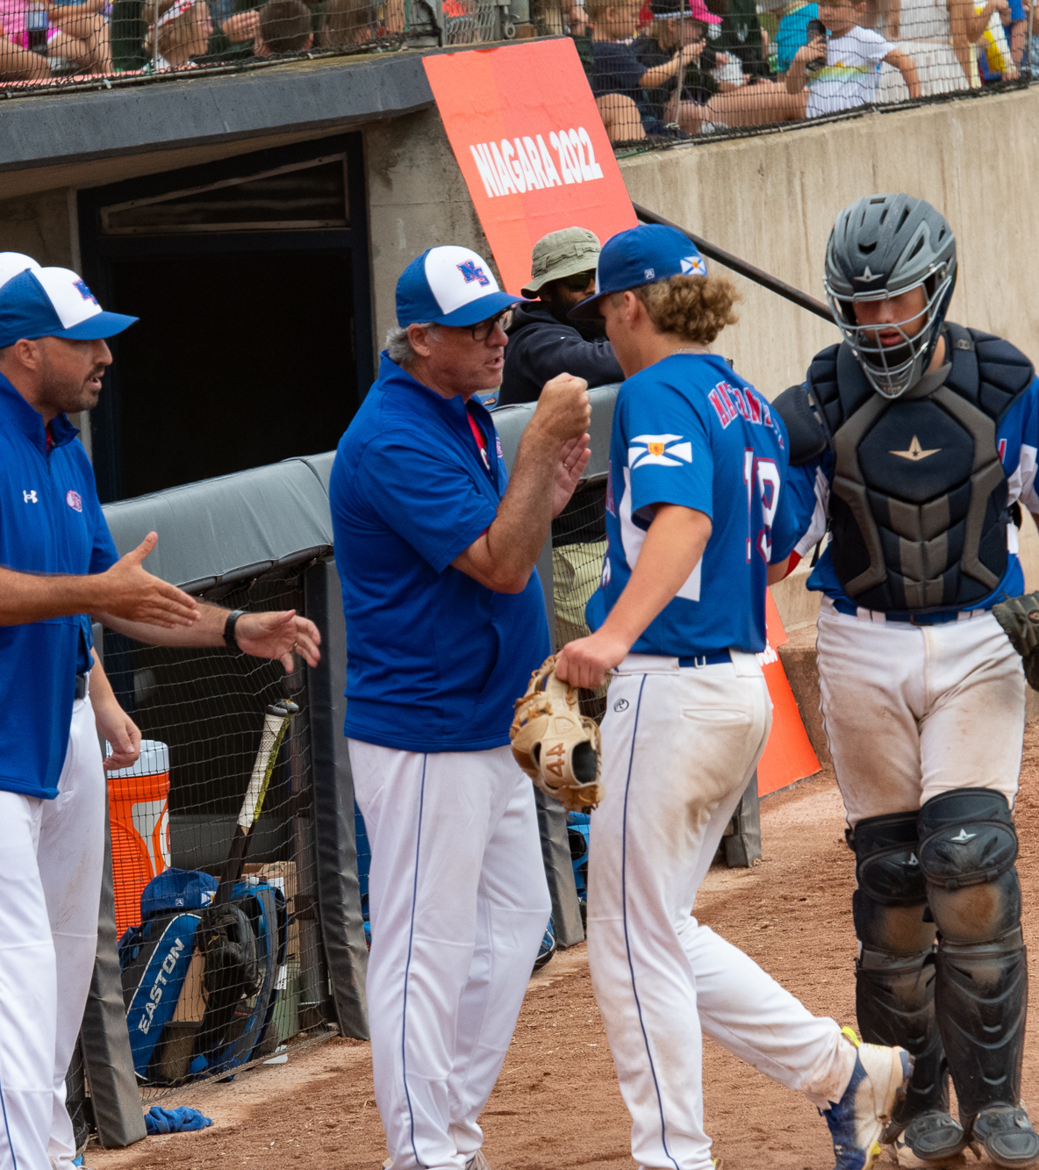
Competition

Slide 11
NCCP Competition - Introduction
<InsertNSO>
IN TRAINING
TRAINED
CERTIFIED
REQUIRED NCCP WORKSHOP
Name of the workshop
Name of the workshop 2
REQUIRED NCCP MODULES
NCCP Make Ethical Decisions
NCCP example 1
NCCP example 2
EVALUATION
NCCP Make Ethical Decisions
Portfolio
Training/Competition Observation
ATHLETES AGED:
8-14
LTD STAGE(S):
Learn to Train
Train to Train
SPORT ENVIRONMENT
School sports (example)
Maintenance of Certification
20 professional development points every 20 years.
To register:
Link to registration to sport-specific training
<InsertNSO>
<InsertPTSO>
Link to registration to multi-sport training
PTCRs
Evaluation Registration
Link to registration
Available Multi-Sport Modules
NCCP Emergency Action Plan
NCCP Basic Mental Skills
NCCP Sport Nutrition
NCCP Planning a Practice
NCCP Teaching and Learning

Slide 12

Competition - Introduction Advanced Gradation
<InsertNSO>
ATHLETES AGED:
8-14
LTD STAGE(S):
Learn to Train
Train to Train
SPORT ENVIRONMENT
School sports (example)
CERTIFIED
ADVANCED
IN TRAINING
TRAINED
EVALUATION
NCCP Make Ethical Decisions
Portfolio
Training/Competition Observation
Additional requirements
REQUIRED NCCP WORKSHOP
Name of the workshop
Name of the workshop 2
REQUIRED NCCP MODULES
NCCP Make Ethical Decisions
NCCP example 1
NCCP example 2
Maintenance of Certification
20 professional development points every 5 years.
To register:
Link to registration to sport-specific training
<InsertNSO>
<InsertPTSO>
Link to registration to multi-sport training
PTCRs
Evaluation Registration
Link to registration

Slide 13
Competition - Development
Coaching Pathways
IN TRAINING
TRAINED
CERTIFIED
REQUIRED NCCP MODULES
Module Example
Module Example 2
REQUIRED NCCP MODULES
NCCP Make Ethical Decisions
NCCP example 1
NCCP example 2
EVALUATION
NCCP Make Ethical Decisions
Portfolio
Training Observation
Competition Observation
ATHLETES AGED:
12+
LTD STAGE(S):
Train to Train
Train to Compete
SPORT ENVIRONMENT
Provincial and National Championships
To register:
Link to registration to sport-specific training
<InsertNSO>
<InsertPTSO>
Link to registration to multi-sport training
PTCRs
Evaluation Registration
Link to registration
Available Multi-Sport Modules
NCCP Advanced Practice Planning
NCCP Coaching and Leading Effectively
NCCP Developing Athletic Abilities
NCCP Leading Drug-Free Sport
NCCP Manage a Sport Program
NCCP Managing Conflict
NCCP Performance Planning
NCCP Prevention and Recovery
Maintenance of Certification
30 professional development points every 5 years.

Slide 14
Competition - Development Advanced Gradation
<InsertNSO>
COACHES AGED:
24+
ATHLETES AGED:
14+
LTD STAGE(S):
Train to Compete
Train to Win
SPORT ENVIRONMENT
National Championships
NextGen International Events
IN TRAINING
TRAINED
CERTIFIED
ADVANCED
EVALUATION
NCCP Make Ethical Decisions
Portfolio
Training Observation
Competition Observation
Advanced Coaching Diploma
CDAG Evaluation
REQUIRED NCCP WORKSHOP
NSO’s Sport Specific Modules
REQUIRED NCCP MODULES
NCCP Make Ethical Decisions
NCCP example 1
NCCP example 2
Maintenance of Certification
30 professional development points every 5 years.
To register:
Link to registration:
Coaching Association of Canada

Slide 15



Competition High Performance
Program Entry
• NSO Targeted Coach
• ChPC Member
Coach Selection Stage
NSO
Competency Feedback
Skills Audit
Panel / Mentor
Discussion
HP
Leadership
Competition
Readiness
Coach Mentoring Stage
Core
Competencies
Coaching HP
Effectively
HP Performance
Plan
Individualized
Professional Development Plan
Coach Certification Stage
Final Review / Presentation
Evidence Meets HP Standard
High Performance
Coach Certification

Slide 16
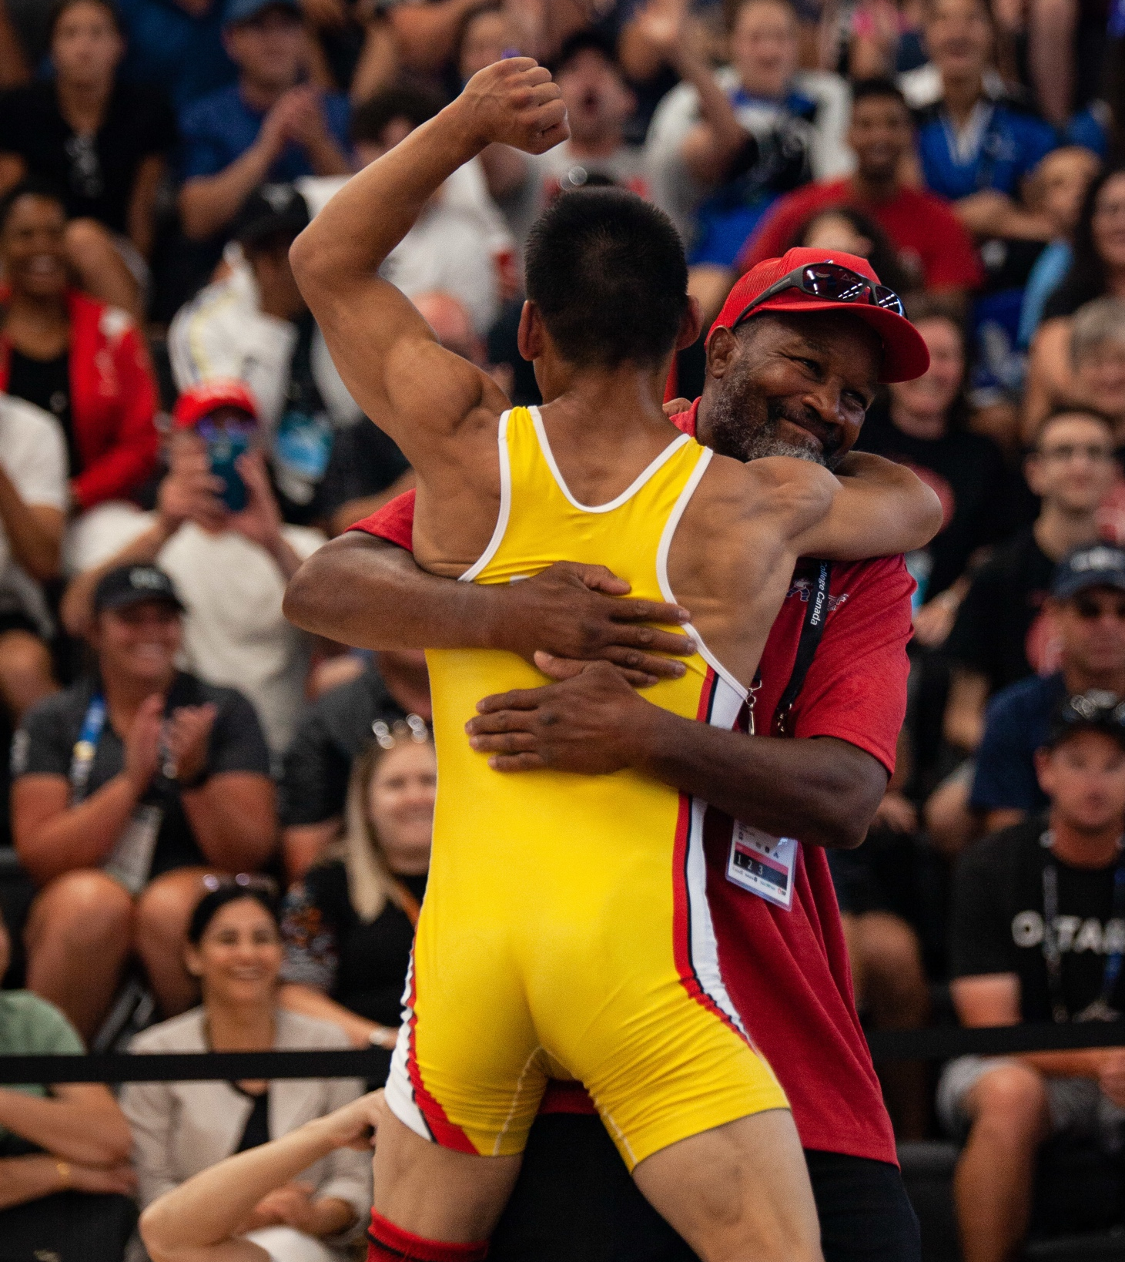
Instruction

Slide 17
NCCP Instruction-Beginner
Coaching Pathways
IN TRAINING
TRAINED
CERTIFIED
REQUIRED NCCP WORKSHOP
Name of the workshop
Name of the workshop 2
REQUIRED NCCP MODULES
NCCP Make Ethical Decisions
NCCP example 1
NCCP example 2
EVALUATION
NCCP Making Ethical Decisions
Portfolio
Training Observation
ATHLETES AGED:
0-9
LTD STAGE(S):
Active Start
FUNdamentals
SPORT ENVIRONMENT
Training environment
Maintenance of Certification
10 professional development points every 5 years.
To register:
Link to registration to sport-specific training
<InsertNSO>
<InsertPTSO>
Link to registration to multi-sport training
PTCRs
Evaluation Registration
Link to registration
Available Multi-Sport Modules
NCCP Emergency Action Plan
NCCP Basic Mental Skills
NCCP Sport Nutrition
NCCP Planning a Practice
NCCP Teaching and Learning

Slide 18
NCCP Instruction- Intermediate
Coaching Pathways
IN TRAINING
TRAINED
CERTIFIED
REQUIRED NCCP WORKSHOP
Name of the workshop
Name of the workshop 2
REQUIRED NCCP MODULES
NCCP Making Ethical Decisions
NCCP example 1
NCCP example 2
EVALUATION
NCCP Making Ethical Decisions
Portfolio
Training/Competition Observation
ATHLETES AGED:
9-12
LTD STAGE(S):
Learn to train
Train to train
SPORT ENVIRONMENT
Training environment
Maintenance of Certification
10 professional development points every 5 years.
To register:
Link to registration to sport-specific training
<InsertNSO>
<InsertPTSO>
Link to registration to multi-sport training
PTCRs
Evaluation Registration
Link to registration
Available Multi-Sport Modules
NCCP Emergency Action Plan
NCCP Basic Mental Skills
NCCP Sport Nutrition
NCCP Planning a Practice
NCCP Teaching and Learning

Slide 19
NCCP
Instruction-Advanced
Coaching Pathways
IN TRAINING
TRAINED
CERTIFIED
REQUIRED NCCP WORKSHOP
Name of the workshop
Name of the workshop 2
REQUIRED NCCP MODULES
NCCP Making Ethical Decisions
NCCP example 1
NCCP example 2
EVALUATION
NCCP Making Ethical Decisions
Portfolio
Training/Competition Observation
ATHLETES :
Learning advanced sport capabilities
LTD STAGE(S):
Train to Compete
Train to Win
Active for Life
SPORT ENVIRONMENT
Training environment
Maintenance of Certification
10 professional development points every 5 years.
To register:
Link to registration to sport-specific training
<InsertNSO>
<InsertPTSO>
Link to registration to multi-sport training
PTCRs
Evaluation Registration
Link to registration
Available Multi-Sport Modules
NCCP Emergency Action Plan
NCCP Basic Mental Skills
NCCP Sport Nutrition
NCCP Planning a Practice
NCCP Teaching and Learning

